Slide 1
Project 1
Deadline
Guarantee
Ratio = 94%
Notes:
2023 Spring: 50 Min Slides 1-24
Next Lecture: Handout 04, Ex 4

Slide 2

Review: IPC Model - Shared Memory
An area of memory shared among the processes that wish to communicate
The communication is under the control of the users processes not the operating system.
Major issues: To synchronize actions when shared memory are accessed.

Slide 3
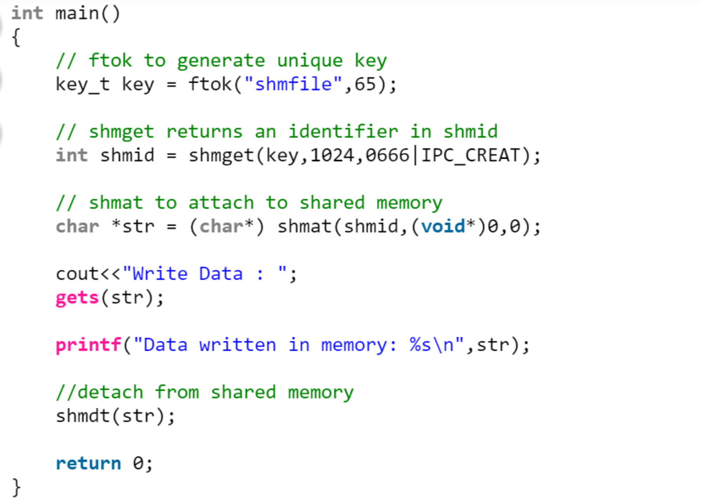
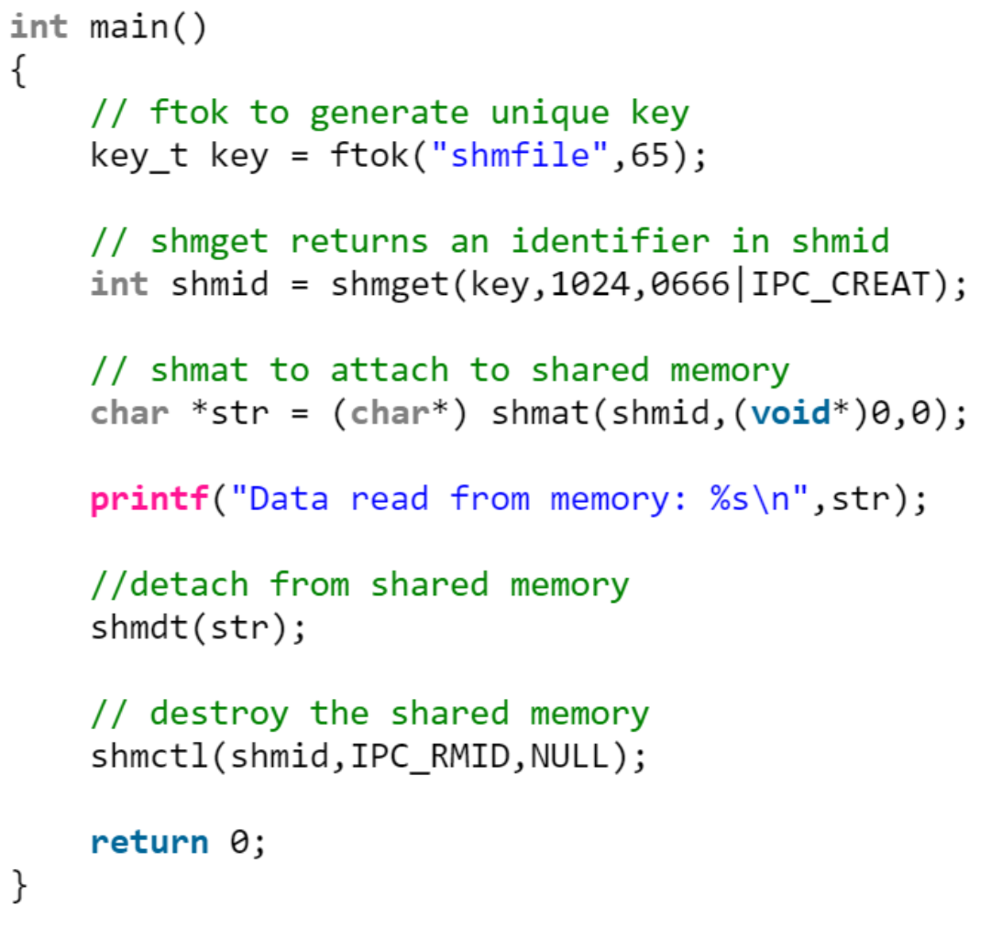
Review

Slide 4
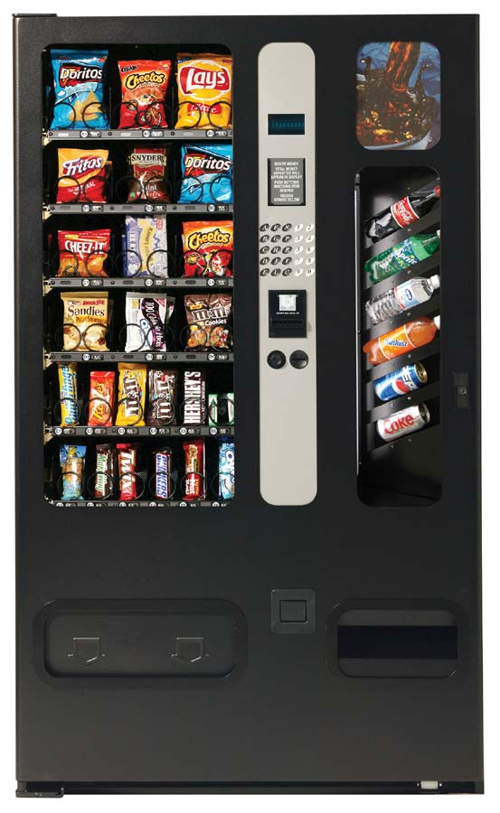



An Example: the soda machine
Soda drinker
(consumer)
Delivery person
(producer)
Vending machine
(buffer)
Is this an unbounded buffer or bounded one?
Slide courtesy of Dr. Jeff Chase at Duke University
Notes:
Principles of Concurrency
Interleaving and overlapping
can be viewed as examples of concurrent processing
both present the same problems
Uniprocessor – the relative speed of execution of processes cannot be predicted
depends on activities of other processes
the way the OS handles interrupts
scheduling policies of the OS
At first glance, it may seem that interleaving and overlapping represent fundamentally different modes of execution and present different problems. In fact, both techniques can be viewed as examples of concurrent processing, and both present the same problems. In the case of a uniprocessor, the problems stem from a basic characteristic of multiprogramming systems: The relative speed of execution of processes cannot be predicted. It depends on the activities of other processes, the way in which the OS handles interrupts, and the scheduling policies of the OS.
The following difficulties arise:
1. The sharing of global resources is fraught with peril. For example, if two processes both make use of the same global variable and both perform reads and writes on that variable, then the order in which the various reads and writes are executed is critical. An example of this problem is shown in the following subsection.
2. It is difficult for the OS to manage the allocation of resources optimally. For example, process A may request use of, and be granted control of, a particular I/O channel and then be suspended before using that channel. It may be undesirable for the OS simply to lock the channel and prevent its use by other processes; indeed this may lead to a deadlock condition, as described in Chapter 6 .
3. It becomes very difficult to locate a programming error because results are typically not deterministic and reproducible (e.g., see [LEBL87, CARR89, SHEN02] for a discussion of this point).
All of the foregoing difficulties present themselves in a multiprocessor system as well, because here too the relative speed of execution of processes is unpredictable. A multiprocessor system must also deal with problems arising from the simultaneous execution of multiple processes. Fundamentally, however, the problems are the same as those for uniprocessor systems. This should become clear as the discussion proceeds.

Slide 5
Bounded-Buffer – Shared-Memory Solution
#define BUFFER_SIZE 10
typedef struct {
. . .
} item;
item buffer[BUFFER_SIZE];
int in = 0;
int out = 0;
Shared Data
Notes:
Can only use BUFFER_SIZE-1 elements?

Slide 6
Code for the producer process.
item next_produced;
while (true) {
/* produce an item in next produced */
while (((in + 1) % BUFFER_SIZE) == out )
; /* do nothing */
buffer[in] = next_produced;
in = (in + 1) % BUFFER_SIZE;
}
Buffer is full
Go to the next empty buffer slot

Slide 7
Code for the consumer process.
item next_consumed;
while (true) { while (in == out )
; /* do nothing */ next_consumed = buffer[out];
out = (out + 1) % BUFFER_SIZE;
/* consume the item in next consumed */
}
Buffer is empty
Go to the next buffer slot

Slide 8
Review: What issue hasn’t been addressed in the above producer-consumer solution?
No issue. It is a perfect solution.
There a debugging problem
There is a race condition problem
There is a user-space problem

Slide 9

COMP7500/7506 Advanced Operating Systems
Message-Passing Systems
Dr. Xiao Qin
Auburn University http://www.eng.auburn.edu/~xqin
xqin@auburn.edu
Notes:
See also Slides 2-5 = 03-Shared Memory Systems Slides 13-16
2018 Spring
45 Minutes: Slides 1-19
Cont. from Slide 20 (see also 07b-Message Passing Systems cont)

Slide 10

Message passing is a mechanism for processes to communicate and to synchronize their actions
Why do we need message queues when we already have the shared memory?
Notes:
Mechanism for processes to communicate and to synchronize their actions
Reference: https://www.tutorialspoint.com/inter_process_communication/inter_process_communication_message_queues.htm
Why do we need message queues when we already have the shared memory? It would be for multiple reasons, let us try to break this into multiple points for simplification −
As understood, once the message is received by a process it would be no longer available for any other process. Whereas in shared memory, the data is available for multiple processes to access.
If we want to communicate with small message formats.
Shared memory data need to be protected with synchronization when multiple processes communicating at the same time.
Frequency of writing and reading using the shared memory is high, then it would be very complex to implement the functionality. Not worth with regard to utilization in this kind of cases.
What if all the processes do not need to access the shared memory but very few processes only need it, it would be better to implement with message queues.
If we want to communicate with different data packets, say process A is sending message type 1 to process B, message type 10 to process C, and message type 20 to process D. In this case, it is simplier to implement with message queues. To simplify the given message type as 1, 10, 20, it can be either 0 or +ve or –ve as discussed below.
Ofcourse, the order of message queue is FIFO (First In First Out). The first message inserted in the queue is the first one to be retrieved.

Slide 11

Processes communicate with each other without resorting to shared variables
Photo courtesy of Enjoy Life Foods
Notes:
Message system – processes communicate with each other without resorting to shared variables

Slide 12
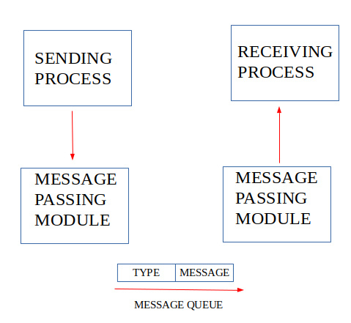
IPC using Message Queues
Diagram courtesy of geeksforgeeks.org

Slide 13
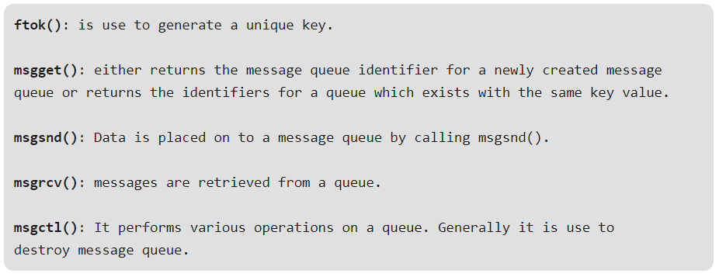
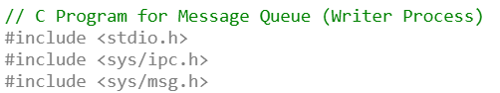

Slide 14
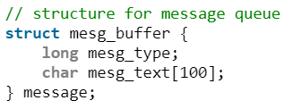
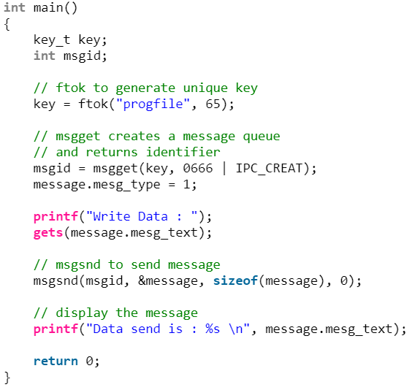
Notes:
ftok() stands for "File TO Key." This function generates a unique identifier -- key -- used for accessing and managing shared memory segments.
Two input parameters are:
pathname: A pointer to a null-terminated string representing the name of an existing file in the filesystem.
proj_id: An integer value used to further differentiate between different keys generated for the same file.
The purpose of ftok() is three-fold:
Identification: Different processes can use the same key to access the same shared memory segment, enabling inter-process communication and data sharing.
Consistency: If multiple processes call ftok with the same path and id, they'll get the same key, ensuring they connect to the same shared memory segment.
Differentiation: Using different paths or ids generates different keys, allowing processes to access distinct shared memory segments if needed.

Slide 15
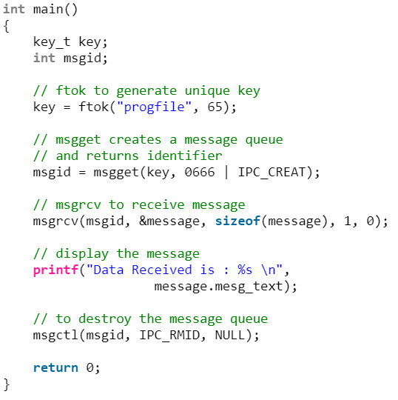
Notes:
int msgsnd(int msqid, const void *msgp, size_t msgsz, int msgflg);
ssize_t msgrcv(int msqid, void *msgp, size_t msgsz, long msgtyp, int msgflg);
The msgflg argument is a bit mask constructed by ORing together zero or more of the following flags:
IPC_NOWAITReturn immediately if no message of the requested type is in the queue. The system call fails with errno set to ENOMSG.
MSG_EXCEPTUsed with msgtyp greater than 0 to read the first message in the queue with message type that differs from msgtyp.
MSG_NOERRORTo truncate the message text if longer than msgsz bytes.

Slide 16
Exercise 1: What are the basic two operations of a message passing system?

Slide 17

send(message)
Photo courtesy of dearfutureme.org
Notes:
IPC facility provides two operations:
send(receiver_ID, message)
receive(message)
The message size is either fixed or variable

Slide 18

receive(message)
Photo courtesy of wvmetronews
Notes:
IPC facility provides two operations:
send(message)
receive(message)
The message size is either fixed or variable

Slide 19

If processes P and Q wish to communicate
Establish a communication link between them
Exchange messages via send/receive

Slide 20

Exercise 2 (Review): Please extend the following prototypes. send(message) receive(message)
Direct Communication
Processes must name each other explicitly
Notes:
Processes must name each other explicitly:
send (P, message) – send a message to process P
receive(Q, message) – receive a message from process Q

Slide 21
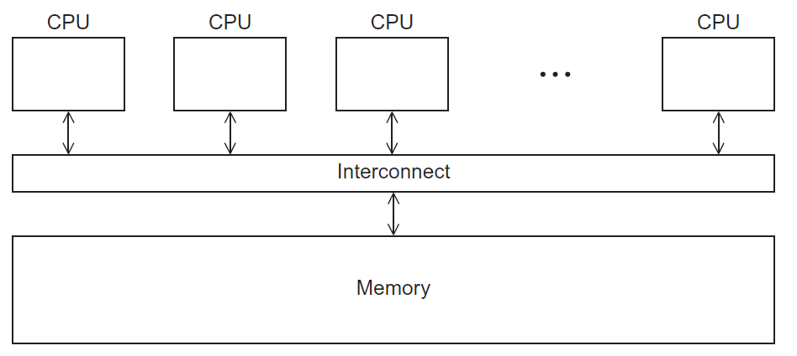
Message Passing on Shared-Memory Systems
Implementation of Communication Links for Message Passing
Notes:
Details will be covered in COMP7300 and COMP7330
Implementation of communication link
Physical:
Shared memory
Hardware bus
Network
Logical:
Direct or indirect
Synchronous or asynchronous
Automatic or explicit buffering

Slide 22
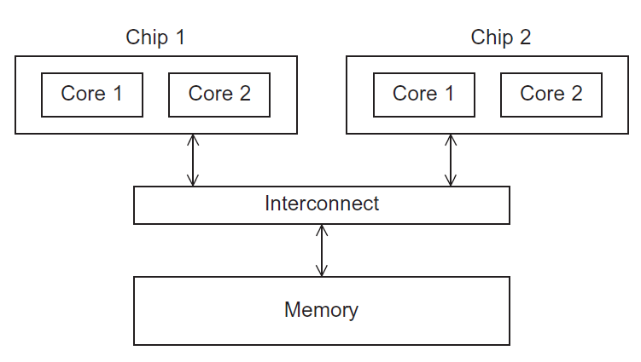
Message Passing on Shared-Memory Systems
Implementation of Communication Links for Message Passing
Notes:
Implementation of communication link
Physical:
Shared memory
Hardware bus
Network
Logical:
Direct or indirect
Synchronous or asynchronous
Automatic or explicit buffering

Slide 23
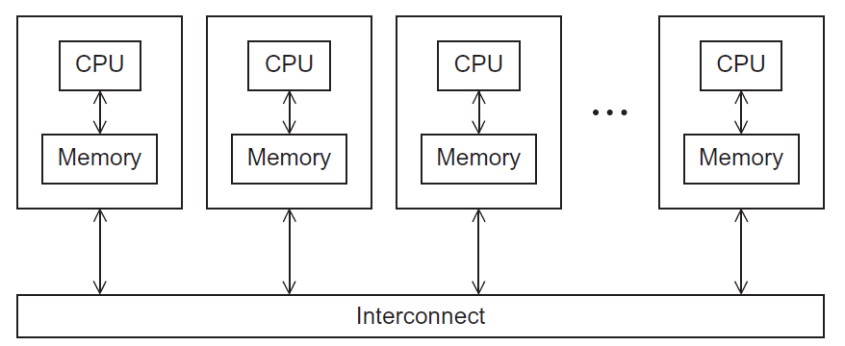
Message Passing on Distributed-Memory Systems
Implementation of Communication Links for Message Passing
Notes:
Implementation of communication link
Physical:
Shared memory
Hardware bus
Network
Logical:
Direct or indirect
Synchronous or asynchronous
Automatic or explicit buffering

Slide 24
Exercise 3 (MS Forms): Suppose you have implemented message passing on a shared-memory system and a distributed-memory system. Which system is more scalable? Why?
Shared-Memory System B) Distributed-Memory System
C) They are equally scalable D) Scalability can’t be measured
Notes:
Implementation of communication link
Physical:
Shared memory
Hardware bus
Network
Logical:
Direct or indirect
Synchronous or asynchronous
Automatic or explicit buffering

Slide 25
Implementation Issues
I
2
Can a link be associated with more than two processes?
3
How many links between a pair of processes?
5
Is the size of a message fixed or variable?
How are links established?
4
Is a link unidirectional or bi-directional?

Slide 26
Exercise 4 (MS Forms): How should communicating processes be associated with a link in direct communication? Why?
A link is associated with multiple pairs of processes
A link is associated with exactly one pair of processes
A link should be associated with any pair of processes
A link is associated with a group of more than two processes

Slide 27
Exercise 5 (MS Forms): Is a link unidirectional or bi-directional in direct communication? Why?
A link is unidirectional
A link is bidirectional
A link is neither unidirectional nor bidirectional
A link has a hybrid mode: either unidirectional or bidirectional
Notes:
The link may be unidirectional, but is usually bi-directional

Slide 28
The Design of Direct Communication
1
2
A link is associated with exactly one pair of processes
3
Between each pair there exists exactly one link
Links are established automatically
4
The link may be unidirectional, but is usually bi-directional
Notes:
Properties of communication link

Slide 29

Indirect Communication
Messages are directed and received from mailboxes (also referred to as ports)
Each mailbox has a unique id
Processes can communicate only if they share a mailbox
Notes:
Fake survey stake.
https://www.pinterest.com/pin/133982157643335832/

Slide 30
Exercise 6 (MS Forms): How should communicating processes be associated with a link in indirect communication?
A link is associated with multiple pairs of processes
A link must only be associated with exactly one pair of processes
No link should be associated with communicating processes
A link is associated with a group of two or more processes

Slide 31
Exercise 7 (MS Forms): How many communication links should each pair of processes share?
Each pair of processes may share several communication links
Each pair of processes must share a single communication links
Each pair of processes must share two communication links
Each pair of processes must share three communication links
Notes:
The link may be unidirectional, but is usually bi-directional

Slide 32
The Design of Indirect Communication
1
2
A link may be associated with many processes
3
Each pair of processes may share several communication links
Link established only if processes share a common mailbox
4
Link may be unidirectional or bi-directional
Notes:
Properties of communication link
Link established only if processes share a common mailbox
A link may be associated with many processes
Each pair of processes may share several communication links
Link may be unidirectional or bi-directional

Slide 33

Exercise 8: What are the four basic operations for indirect communication?
Create a new mailbox (port)
Send messages through mailbox
Receive messages through mailbox
Destroy a mailbox

Slide 34
Exercise 9: Please design the prototypes for the following two operations for indirect communication.
Send( );
Receive( );
Notes:
Primitives are defined as:
send(A, message) – send a message to mailbox A
receive(A, message) – receive a message from mailbox A

Slide 35
Exercise 10: Mailbox Sharing
P₁, P₂, and P₃ share mailbox A
P₁, sends; P₂ and P₃ receive
Who gets the message?
Allow a link to be associated with at most two processes
Allow only one process at a time to execute a receive operation
Allow the system to select arbitrarily the receiver. Sender is notified who the receiver was.

Slide 36

Summary: IPC Model – Message Passing
What are the two operations?
What are direct and indirect communications?
What are implementation issues?
Notes:
Cont. ch3.ppt, slide 44 Synchronization

